Slide 1
Data Mining for Business
Ensembles in Machine Learning
Dr. Kamesam

Slide 2



Data Mining /
Machine Learning
Supervised Learning
Unsupervised
Learning
Classification
Regression
Clustering
Association Rules
Linear Regression
Nonlinear Regression
DT,
ANN, SVM
C&RT, KNN
Log. Regression
Apriori
Algorithm
K Means
Hierarchical
MLR
ANN,
C&RT
Ensembles can be used for both Regression, Classification

Slide 3

Ensembles in Machine Learning
Ensemble: a group of people or things that make up a complete unit (such as a musical group, a group of actors or dancers, or a set of clothes)

Slide 4
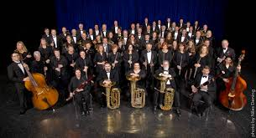
Ensembles in Machine Learning
Ensemble: a group of people or things that make up a complete unit (such as a musical group, a group of actors or dancers, or a set of clothes)

Slide 5
Ensemble Learning
So far – learning methods that learn a single hypothesis, chosen from a hypothesis space that is used to make predictions.
Ensemble learning → Build a collection (ensemble) of models and combine their predictions.
Idea: Generate a number of different decision trees and have them vote on the best classification for a new example.
Key motivation: reduce the classification error rate.
Hope : it will become much more unlikely that the ensemble will misclassify an example.

Slide 6
Machine Learning Ensembles
Learn multiple alternative definitions of a concept using different training data or different learning algorithms.
Combine decisions of multiple definitions, e.g. using weighted voting.
Training Data
⋅ ⋅ ⋅ ⋅ ⋅ ⋅ ⋅ ⋅
Data1
Data2
Data m
Learner1
Learner2
⋅ ⋅ ⋅ ⋅ ⋅ ⋅ ⋅ ⋅
Learner m
⋅ ⋅ ⋅ ⋅ ⋅ ⋅ ⋅ ⋅
Model1
Model2
Model m
Model Combiner
Final Model

Slide 7





Example: Weather Forecast
Day 1 Day 2 Day 3 Day 4 Day 5 Day 6 Day 6
TARGET
Forecast 1
Forecast 2
Forecast 3
Forecast 4
Forecast 5
Majority
X
X
X
X
X
X
X
X
X
X
X
Majority Vote Classification correct on all days
X
X

Slide 8
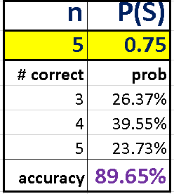
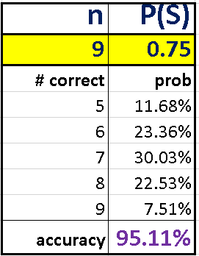
Motivation
n Independent judges, each making the correct decision 75% of the time
Probability( majority of them will reach the correct decision) ?
Binomial ( n, p) with (ex: n = 5 or 9) , p = 0.75
It is tempting to build several weak classifiers, and take the majority vote

Slide 9
General Process for Ensembles

Slide 10
Different types of ensemble learning
Different learning algorithms
Algorithms with different choice for parameters
Data set with different features (e.g. random subset)
Data set = different subsets (e.g. bagging, boosting)

Slide 11
Combining an ensemble of classifiers
Voting: Different voting schemes can be used
Simple Majority Voting
Each base-level classifier gives a (weighted) vote for its prediction
The Classifier with the highest confidence wins
Many other options
SPSS Modeler offers several options
For Regression: Average the predictions of the different learners

Slide 12
Well Known Ensemble Techniques
Bagging (Bootstrap Aggregating )
Random Forests
Boosting
First of all, what are Bootstrap Samples?

Slide 13
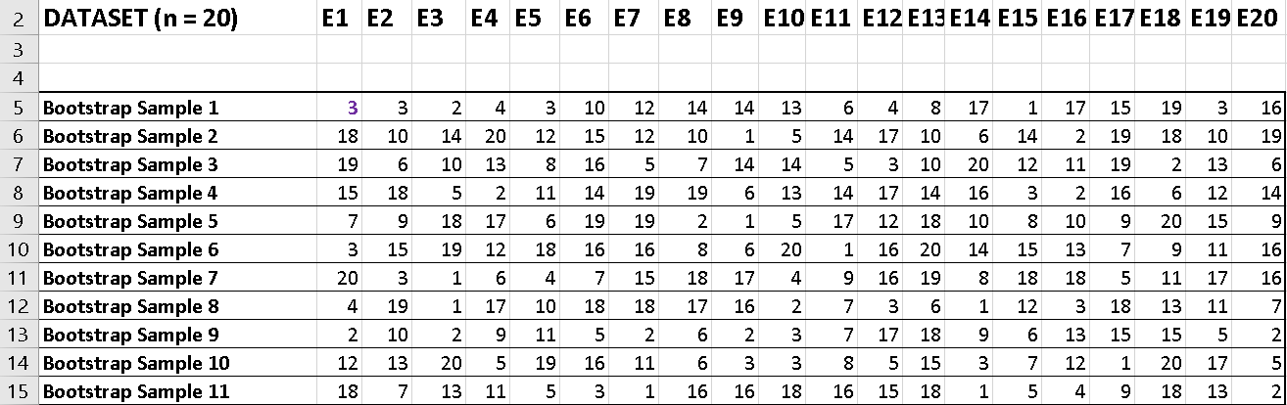
Bootstrap Sampling in Machine Learning
Dataset: 20 examples (E1,E2, .........., E20)
Random sample with replacement of same size ( n = 20)
Sample 1 (row 5) : ( E3, E4, E14, E17) repeated. (E5,E7,E9,E11,E18) missing
Sample 2 (row 6) : (E10, E12,E14, E18, E19) repeated.
For n large, each bootstrap sample expected to have nearly 63% of original data

Slide 14
Ensemble methods
A single decision tree may not perform well
But, it is super fast
What if we learn multiple trees (on different data?)
Only have one dataset Bootstrap Samples
We need to make sure they do not all just learn the same

Slide 15
Bagging
If we split the data in random different ways, decision trees give different results, high variance.
If we had multiple realizations of the data (or bootstrap samples) we could calculate the predictions multiple times and take the average. Averaging multiple onerous estimations produce less uncertain results
Bagging: Bootstrap aggregating is a method that results in low variance.
Notes:
General purpose method, here only for decision trees

Slide 16
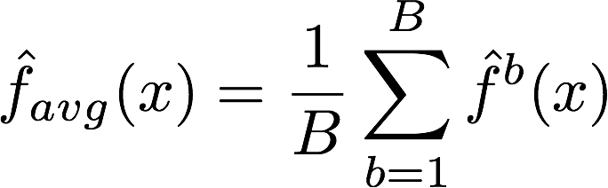
Bagging
Say for each sample b, we calculate f^{b}(x), then:
How?
Bootstrap
Construct B (hundreds) of trees (no pruning)
Learn a classifier for each bootstrap sample and average them
Very effective
Notes:
No pruning, high bias high variance

Slide 17
Bagging (and Random Forests) do not Over Fit
X₂
X₁

Slide 18

Random Forests
Notes:
Random Forests 是特殊的bagging，使用crt作为弱学习机器
首先，RF使用了CART决策树作为弱学习器，这让我们想到了梯度提示树GBDT。第二，在使用决策树的基础上，RF对决策树的建立做了改进，对于普通的决策树，我们会在节点上所有的n个样本特征中选择一个最优的特征来做决策树的左右子树划分，但是RF通过随机选择节点上的一部分样本特征，这个数字小于n，假设为𝑛𝑠𝑢𝑏nsub，然后在这些随机选择的𝑛𝑠𝑢𝑏nsub个样本特征中，选择一个最优的特征来做决策树的左右子树划分。这样进一步增强了模型的泛化能力。
如果𝑛𝑠𝑢𝑏=𝑛nsub=n，则此时RF的CART决策树和普通的CART决策树没有区别。𝑛𝑠𝑢𝑏nsub越小，则模型约健壮，当然此时对于训练集的拟合程度会变差。也就是说𝑛𝑠𝑢𝑏nsub越小，模型的方差会减小，但是偏倚会增大。在实际案例中，一般会通过交叉验证调参获取一个合适的𝑛𝑠𝑢𝑏nsub的值。
除了上面两点，RF和普通的bagging算法没有什么不同， 下面简单总结下RF的算法。
输入为样本集𝐷={(𝑥,𝑦1),(𝑥2,𝑦2),...(𝑥𝑚,𝑦𝑚)}D={(x,y1),(x2,y2),...(xm,ym)}，弱分类器迭代次数T。
输出为最终的强分类器𝑓(𝑥)f(x)
1）对于t=1,2...,T:
a)对训练集进行第t次随机采样，共采集m次，得到包含m个样本的采样集𝐷𝑡Dt
b)用采样集𝐷𝑡Dt训练第t个决策树模型𝐺𝑡(𝑥)Gt(x)，在训练决策树模型的节点的时候， 在节点上所有的样本特征中选择一部分样本特征， 在这些随机选择的部分样本特征中选择一个最优的特征来做决策树的左右子树划分
2) 如果是分类算法预测，则T个弱学习器投出最多票数的类别或者类别之一为最终类别。如果是回归算法，T个弱学习器得到的回归结果进行算术平均得到的值为最终的模型输出。

Slide 19
Bagging vs. Random Forests
Bagging
Random Forests
Boosting
Even with Bagging, the decision trees on bootstrap samples may be similar (hence correlated) since each tree may split on the same set of features, in the same order
Random Forests are an improvement over Bagging. They attempt to eliminate (reduce) the correlations.

Slide 20
Random Forests
As in bagging, we build a number of decision trees on bootstrapped training samples
Let p = number of features in the original dataset
each time a split in a tree is considered, a random sample of m (out of p) predictors is chosen as split candidates
Each tree uses a different dataset, and different set of features in splitting decisions. Such trees are uncorrelated.
m is often chosen as the square root of p
Note that if m = p, then this is bagging.

Slide 21
Random Forests
Random forests are popular.
Leo Breiman’s and Adele Cutler maintains a random forest website where the software is freely available, and of course it is included in every ML/STAT package
Random Forests Do not Over Fit. (i.e. even as the number of trees in the ensemble increases, there is NO OVERFIT.
http://www.stat.berkeley.edu/~breiman/RandomForests/
Notes:
RF的算法原理也终于讲完了，作为一个可以高度并行化的算法，RF在大数据时候大有可为。 这里也对常规的随机森林算法的优缺点做一个总结。
RF的主要优点有：
1） 训练可以高度并行化，对于大数据时代的大样本训练速度有优势。个人觉得这是的最主要的优点。
2） 由于可以随机选择决策树节点划分特征，这样在样本特征维度很高的时候，仍然能高效的训练模型。
3） 在训练后，可以给出各个特征对于输出的重要性
4） 由于采用了随机采样，训练出的模型的方差小，泛化能力强。
5） 相对于Boosting系列的Adaboost和GBDT， RF实现比较简单。
6） 对部分特征缺失不敏感。
RF的主要缺点有：
1）在某些噪音比较大的样本集上，RF模型容易陷入过拟合。
2) 取值划分比较多的特征容易对RF的决策产生更大的影响，从而影响拟合的模型的效果。

Slide 22
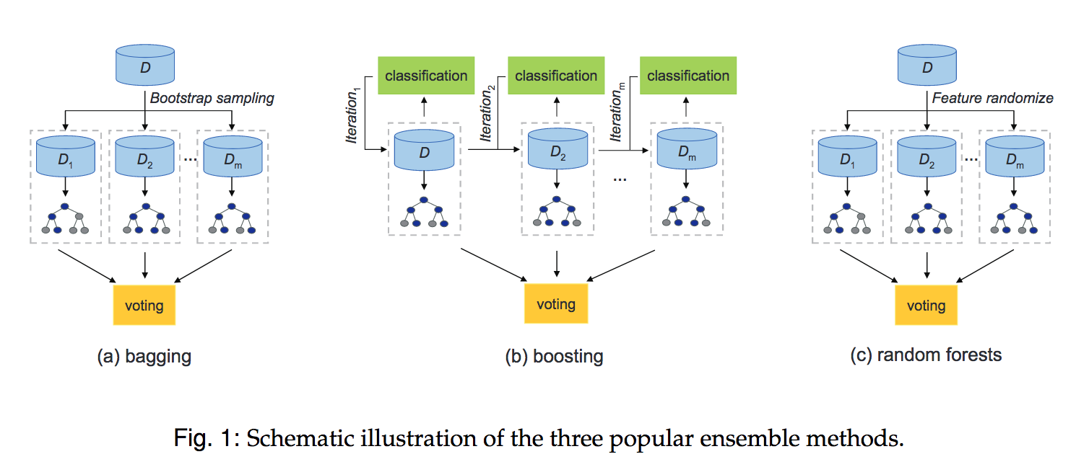
Ensemble learning
Weak learner ensembles (each base learner has high Error Rate, but is easy to train):
Current Bioinformatics, 5, (4):296-308,

Slide 23
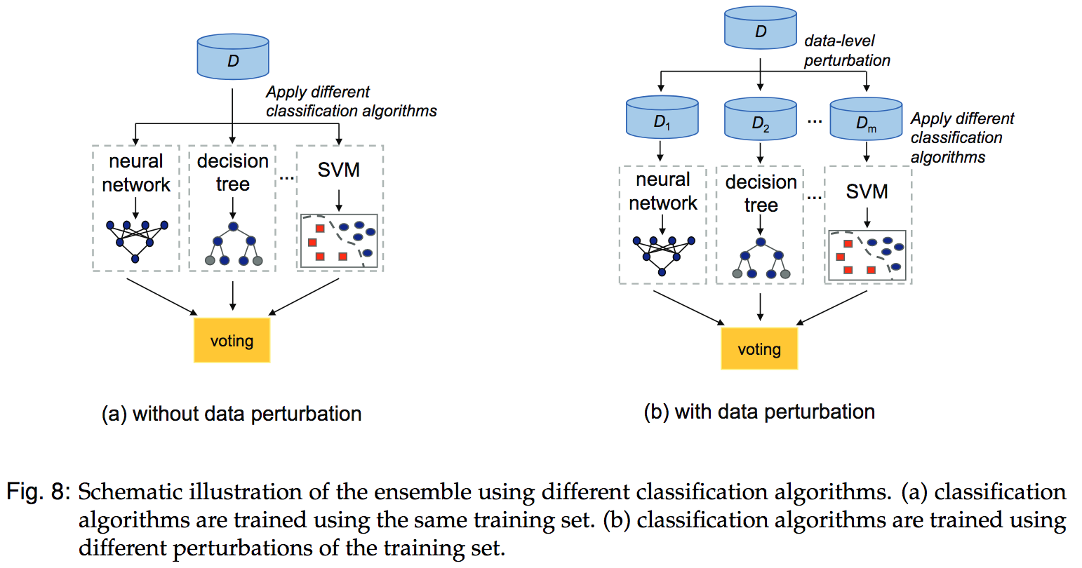
Ensemble learning
Strong learner ensembles (“Stacking” and beyond):
Current Bioinformatics, 5, (4):296-308, 2010.

Slide 24
Outline
Bagging
Random Forests
Boosting

Slide 25
Boosting
Boosting is a general approach that can be applied to many statistical learning methods for regression or classification.
Bagging: Generate multiple trees from bootstrapped data and average the trees. Recall bagging results in i.d. trees and not i.i.d.
Random Forests produce i.i.d (or more independent) trees by randomly selecting a subset of predictors at each step

Slide 26
Boosting
Boosting works very differently.
Boosting does not involve bootstrap sampling
Trees are grown sequentially: each tree is grown using information from previously grown trees
Like bagging, boosting involves combining a number of decision trees, f¹, . . . , f^{B}

Slide 27
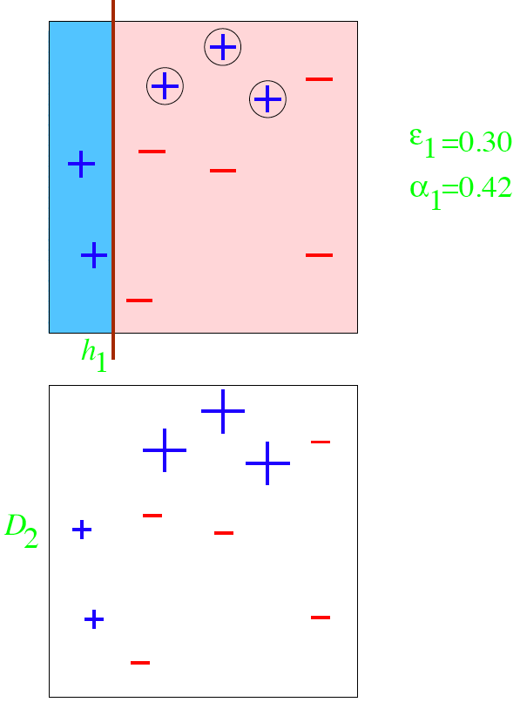
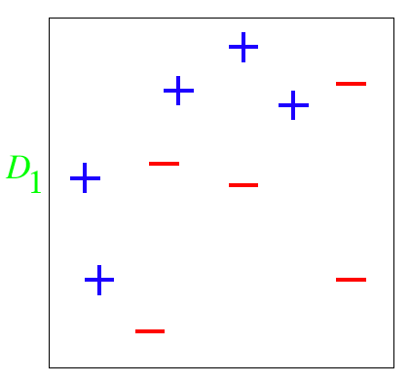
Boosting
“A Tutorial on Boosting”,Yoav Freund and Rob Schapire

Slide 28
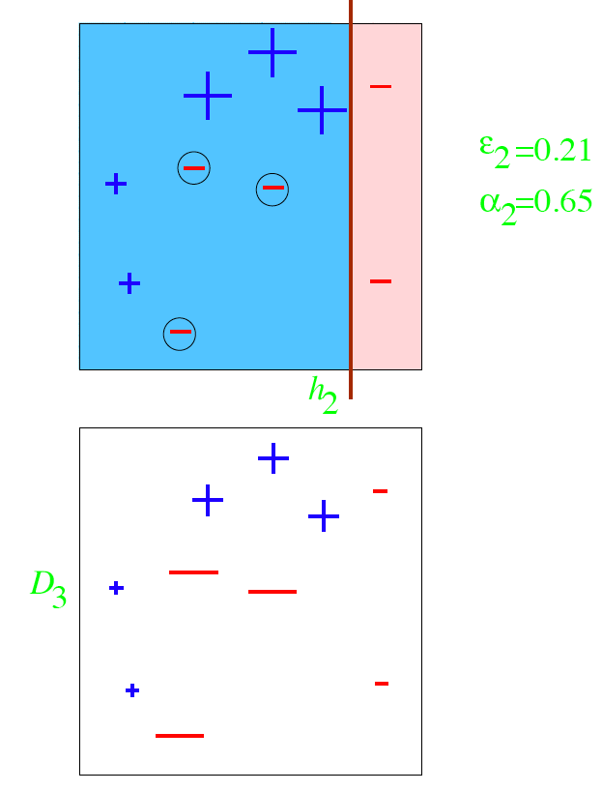
Boosting
“A Tutorial on Boosting”,Yoav Freund and Rob Schapire

Slide 29
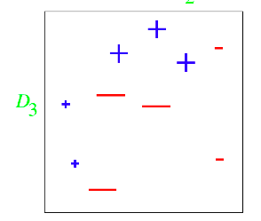
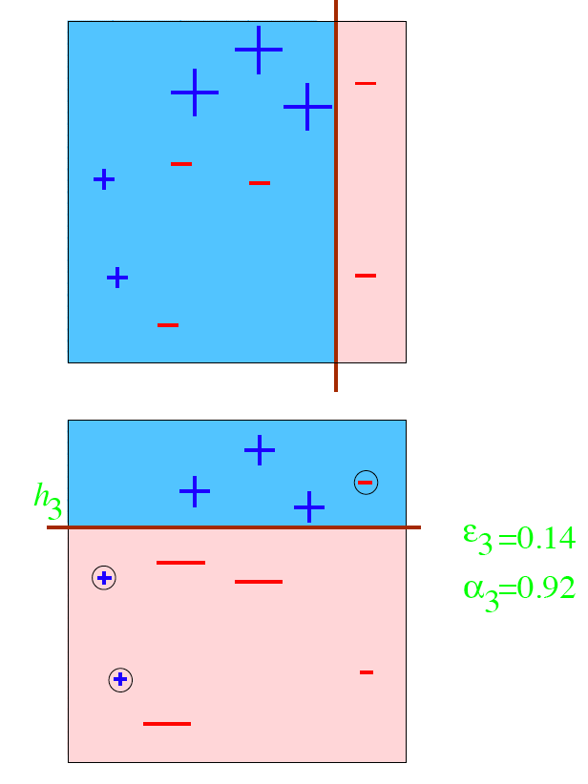
Boosting
“A Tutorial on Boosting”,Yoav Freund and Rob Schapire

Slide 30

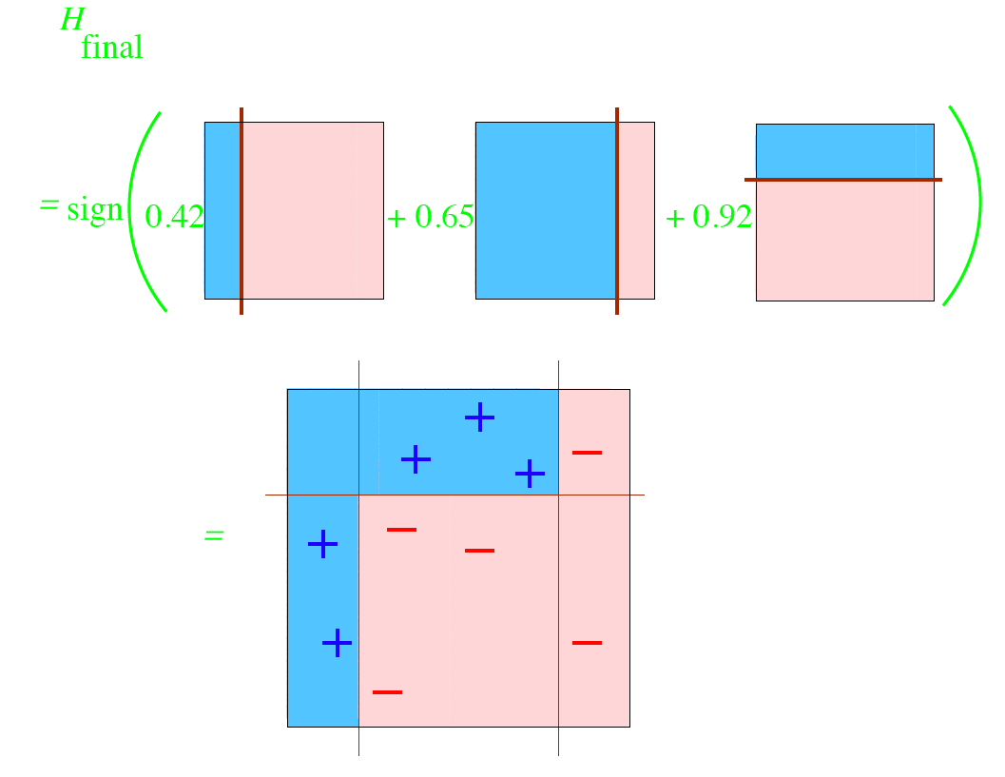
Boosting
“A Tutorial on Boosting”,Yoav Freund and Rob Schapire
Notes:
Boost通过迭代优化分类结果
（boosting和bagging都用于同质弱机器学习）

Slide 31
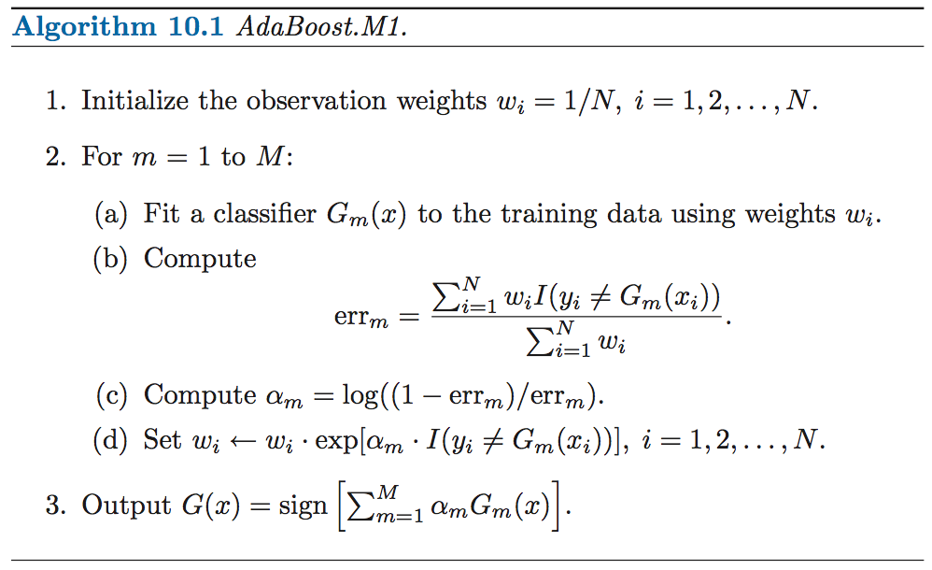
Boosting

Slide 32
End of Lecture

Slide 33
Binomial Distribution

Slide 34
Binomial Experiments
There are many probability experiments for which the results of each trial can be reduced to two outcomes: success and failure. For instance, when a basketball player attempts a free throw, he or she either makes the basket or does not. Probability experiments such as these are called binomial experiments.

Slide 35
Definition
A binomial experiment is a probability experiment that satisfies the following conditions:
1. The experiment is repeated for a fixed number of trials, where each trial is independent of the other trials.
2. There are only two possible outcomes of interest for each trial. The outcomes can be classified as a success (S) or as a failure (F).
3. The probability of a success, P(S), is the same for each trial.
4. The random variable, x, counts the number of successful trials.

Slide 36
Notation for Binomial Experiments
Symbol | Description
n | The number of times a trial is repeated.
p = P(S) | The probability of success in a single trial.
q = P(F) | The probability of failure in a single trial (q = 1 – p)
x | The random variable represents a count of the number of successes in n trials: x = 0, 1, 2, 3, . . . n.

Slide 37
Note:
Here is a simple example of binomial experiment. From a standard deck of cards, you pick a card, note whether it is a club or not, and replace the card. You repeat the experiment 5 times, so n = 5. The outcomes for each trial can be classified in two categories: S = selecting a club and F = selecting another suit. The probabilities of success and failure are:
p = P(S) = ¼ and q = P(F) = ¾.
The random variable x represents the number of clubs selected in the 5 trials. So, the possible values of the random variable are 0, 1, 2, 3, 4, and 5. Note that x is a discrete random variable because its possible values can be listed.

Slide 38
Ex. 1: Binomial Experiments
Decide whether the experiment is a binomial experiment. If it is, specify the values of n, p and q and list the possible values of the random variable, x. If it is not, explain why.
1. A certain surgical procedure has an 85% chance of success. A doctor performs the procedure on eight patients. The random variable represents the number of successful surgeries.

Slide 39
Ex. 1: Binomial Experiments
Solution: the experiment is a binomial experiment because it satisfies the four conditions of a binomial experiment. In the experiment, each surgery represents one trial. There are eight surgeries, and each surgery is independent of the others. Also, there are only two possible outcomes for each surgery—either the surgery is a success or it is a failure. Finally, the probability of success for each surgery is 0.85.
n = 8
p = 0.85
q = 1 – 0.85 = 0.15
x = 0, 1, 2, 3, 4, 5, 6, 7, 8

Slide 40
Ex. 2: Binomial Experiments
Decide whether the experiment is a binomial experiment. If it is, specify the values of n, p and q and list the possible values of the random variable, x. If it is not, explain why.
2. A jar contains five red marbles, nine blue marbles and six green marbles. You randomly select three marbles from the jar, without replacement. The random variable represents the number of red marbles.

Slide 41
Ex. 2: Binomial Experiments
Solution: The experiment is not a binomial experiment because it does not satisfy all four conditions of a binomial experiment. In the experiment, each marble selection represents one trial and selecting a red marble is a success. When selecting the first marble, the probability of success is 5/20. However because the marble is not replaced, the probability is no longer 5/20. So the trials are not independent, and the probability of a success is not the same for each trial.

Slide 42
EX3: Random variable example
Flip a fair coin 3 times. Random variable is Y = number of heads
Outcome HHH HHT HTH THH HTT THT TTH TTT
Prob 1/8 1/8 1/8 1/8 1/8 1/8 1/8 1/8
Y 3 2 2 2 1 1 1 0
So the random variable Y is specified as
Y 0 1 2 3
Prob 1/8 3/8 3/8 1/8

Slide 43
Binomial Probabilities
There are several ways to find the probability of x successes in n trials of a binomial experiment. One way is to use the binomial probability formula.
Binomial Probability Formula
In a binomial experiment, the probability of exactly x successes in n trials is:

Slide 44
Ex. 4 Finding Binomial Probabilities
A six sided die is rolled 3 times. Find the probability of rolling exactly one 6
Use the binomial probability formula. In this binomial experiment, rolling a 6 is a success while rolling any other number is a failure. The values for n, p, q, and x are
n = 3,
p = 1/6,
q = 5/6 and
x = 1.
The probability of rolling exactly one 6 is on the next page

Slide 45
Ex. 4 Finding Binomial Probabilities
By listing the possible values of x with the corresponding probability of each, you can construct a binomial probability distribution.

Slide 46
Ex 5: voter preference
In the US, 47% of all eligible voters are democrats
If you take a random sample of 100 voters, what is the probability that 60 out of the 100 are democrats.
Can this probability be calculated using the binomial distribution?

Slide 47
Ex: 6 Multiple Classifiers
Given a classification problem, suppose we build 10 classifiers. Suppose each classifier’s correct classification probability = p. One classifier’s accuracy does not affect another classifier’s accuracy.
Let X = number of classifiers that classify correctly
Is X a binomial random variable?

Slide 48
Back Up Charts

Slide 49

Power of the crowds
Wisdom of the crowds
http://www.scaasymposium.org/portfolio/part-v-the-power-of-innovation-and-the-market/

Slide 50
Different types of ensemble learning (1)
Different algorithms, same set of training data
A1
C1
Training
Set L
A2
C2
…
…
An
Cn
A: algorithm I; C: classifier

Slide 51
Different types of ensemble learning (2)
Same algorithm, different parameter settings
C1
P1
Training
Set L
A
P2
C2
Pn
…
Cn
P: parameters for the learning algorithm

Slide 52
Different types of ensemble learning (3)
Same algorithm, different versions of data set, e.g.
Bagging: resample training data
Boosting: Reweight training data
Decorate: Add additional artificial training data
RandomSubSpace (random forest): random subsets of features
L1
C1
Training
Set L
L2
A
C2
…
…
Ln
Cn

Slide 53
Sequential fitting in Boosting
Given the current model,
we fit a decision tree to the residuals from the model. Response variable now is the residuals and not Y
We then add this new decision tree into the fitted function in order to update the residuals
The learning rate has to be controlled

Slide 54


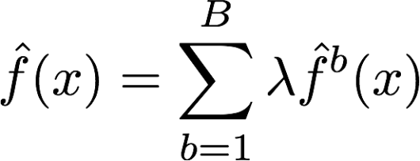
Boosting for regression
1. Set f(x)=0 and r_{i} =y_{i} for all i in the training set.
2. For b=1,2,...,B, repeat:
a. Fit a tree with d splits(+1 terminal nodes) to the training data (X, r).
b. Update the tree by adding in a shrunken version of the new tree:
c. Update the residuals,
3. Output the boosted model,

Slide 55
Boosting tuning parameters
The number of trees B. RF and Bagging do not overfit as B increases. Boosting can overfit! Cross Validation
The shrinkage parameter λ, a small positive number. Typical values are 0.01 or 0.001 but it depends on the problem. λ only controls the learning rate
The number d of splits in each tree, which controls the complexity of the boosted ensemble. Stumpy trees, d = 1 works well.

Slide 56
Classification Error of Ensembles

